Slide 1
Football club management
Scenario, Entity relationship diagram and Relationship schema
Sanjay Malakar
1505057
Shoumik Saha
1505059

Slide 2
Scenario :
A football club has many teams, players, committee, staffs and members . There are different types of staffs such as managers, scouts , medical staffs. Every team has individual players, captain, managers, scouts, medical team. Each player has an player id, name, nationality, playing position, salary etc and plays in a particular team. Players can be transferred to or from a different club and this history will be saved. Every team plays many matches of different tournaments and the data of these matches will have to be stored. Every match has match id, venue, date, opponent, result etc. Again, performances of every players in different matches will be stored along with their goals, fouls, saves, rating etc.
Every manager has an id, name, nationality etc. Every team has scouts who look for players in different regions. Again, a medical team assigned for every team which is consisted of more than one staffs. Every medical team has a head medical staff.
Committee is consisted of board members( president, vice president, treasurer, secretary) who are either staff or member. A new committee is formed in every year and this history will be stored. One can become member of the club by registering for a certain period.

Slide 3
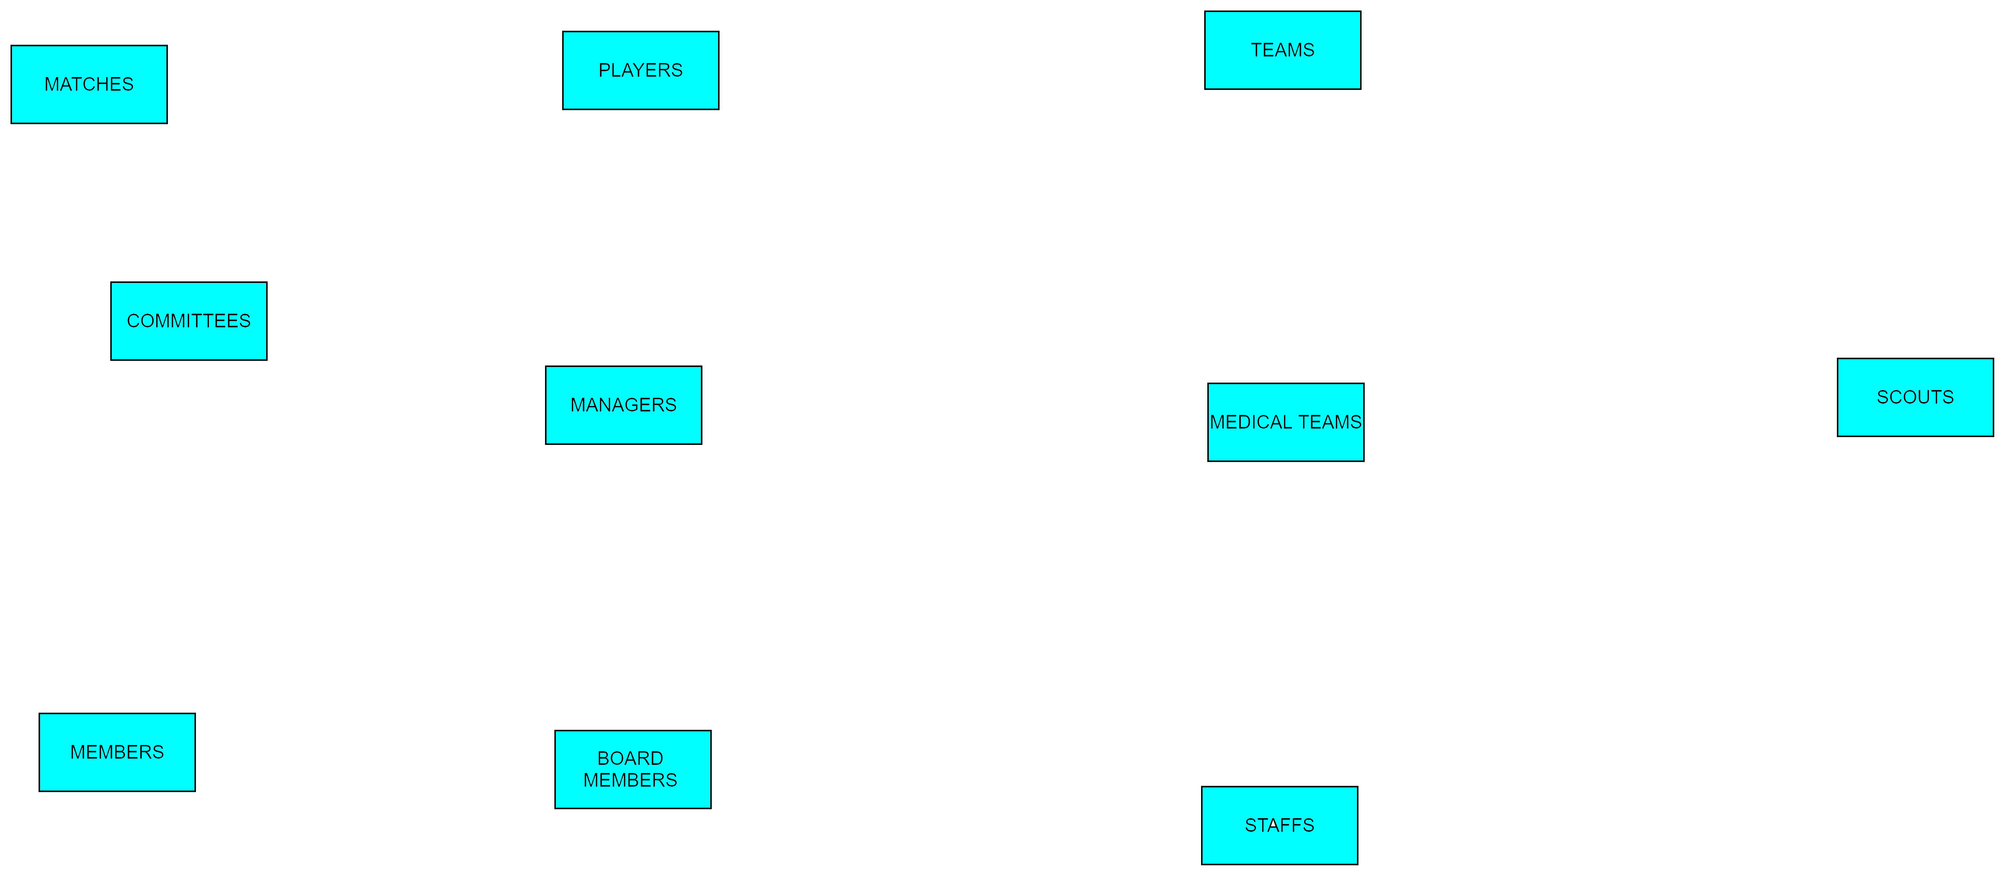
ERD:

Slide 4
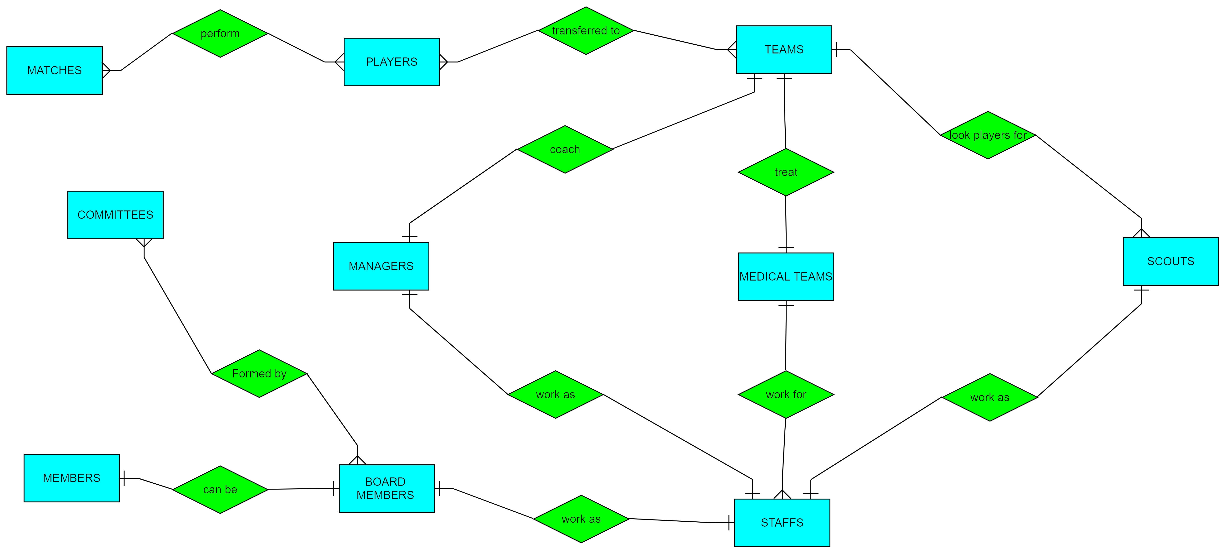
ERD:

Slide 5
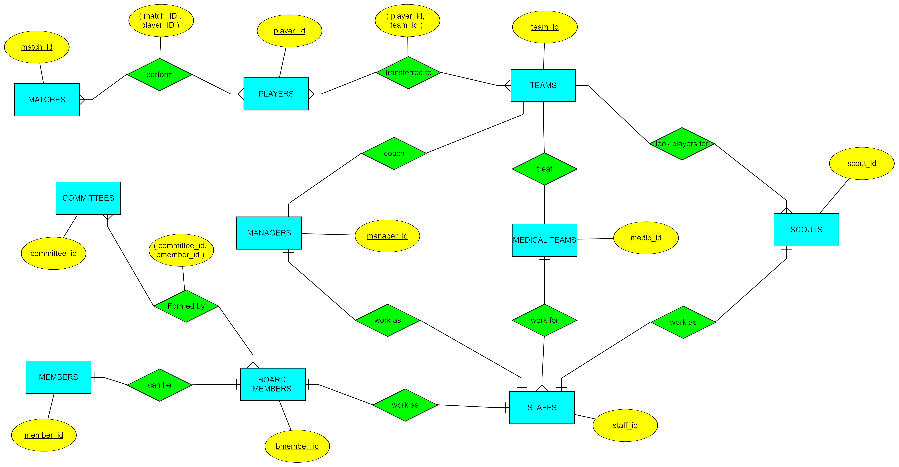
ERD:

Slide 6
Schema:
Team (team_id, team_name, manager_id, scout_id,
medic_id, captain )
2. Player (player_id, player_name, date_of_birth,
nationality, position, height, weight, contact_no,
wage, contract till, market_value , buy_out_clause,
agent_name )
3. Match (match_id, date , venue , opponent,
Tournament_name, stage, result )

Slide 7
Schema:
4. Staffs (staff_id, staff_name, address, contact_no,
sdate, edate, type , salary )
5. Managers (manager_id, team_id, staff_id,
nationality, no_of_trophies )
6. Scouts ( scout_id, team_id, staff_id,
scouting_region , reporting_date )
7. Medical_Teams ( medic_id , team_id, staff_id,
no_of_members , chief_name )

Slide 8
Schema:
8. Board_members ( bmember_id, profession )
9. Committees ( committee_id, start_date,
end_date , budget, total_income )
10. Members (member_id , member_name ,
member_address, member_contact_no,
email, membership_type, valid_till)

Slide 9
Relational entity :
11. Player_Match (match_id (fk1), player_id
(fk2) , minutes_played ,goals , fouls, saves,
Rating )
12. Player_Team ( transfer_id, player_id(fk1),
Team_id(fk2), from , date, amount , isLoan)
13. Committee_Board ( committee_id(fk1),
bmember_id(fk2), role )

Slide 10
Thank YOU

